Slide 1
Uvalde Community Behavioral Health Services for Southwest Texas Communities

Slide 2
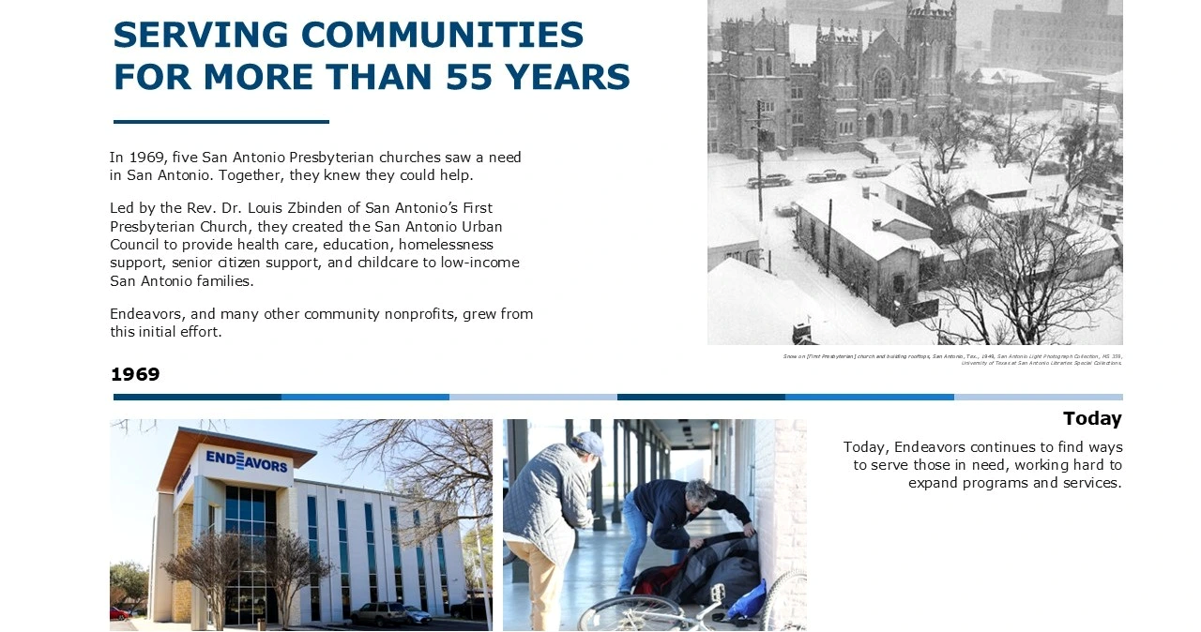

Slide 3
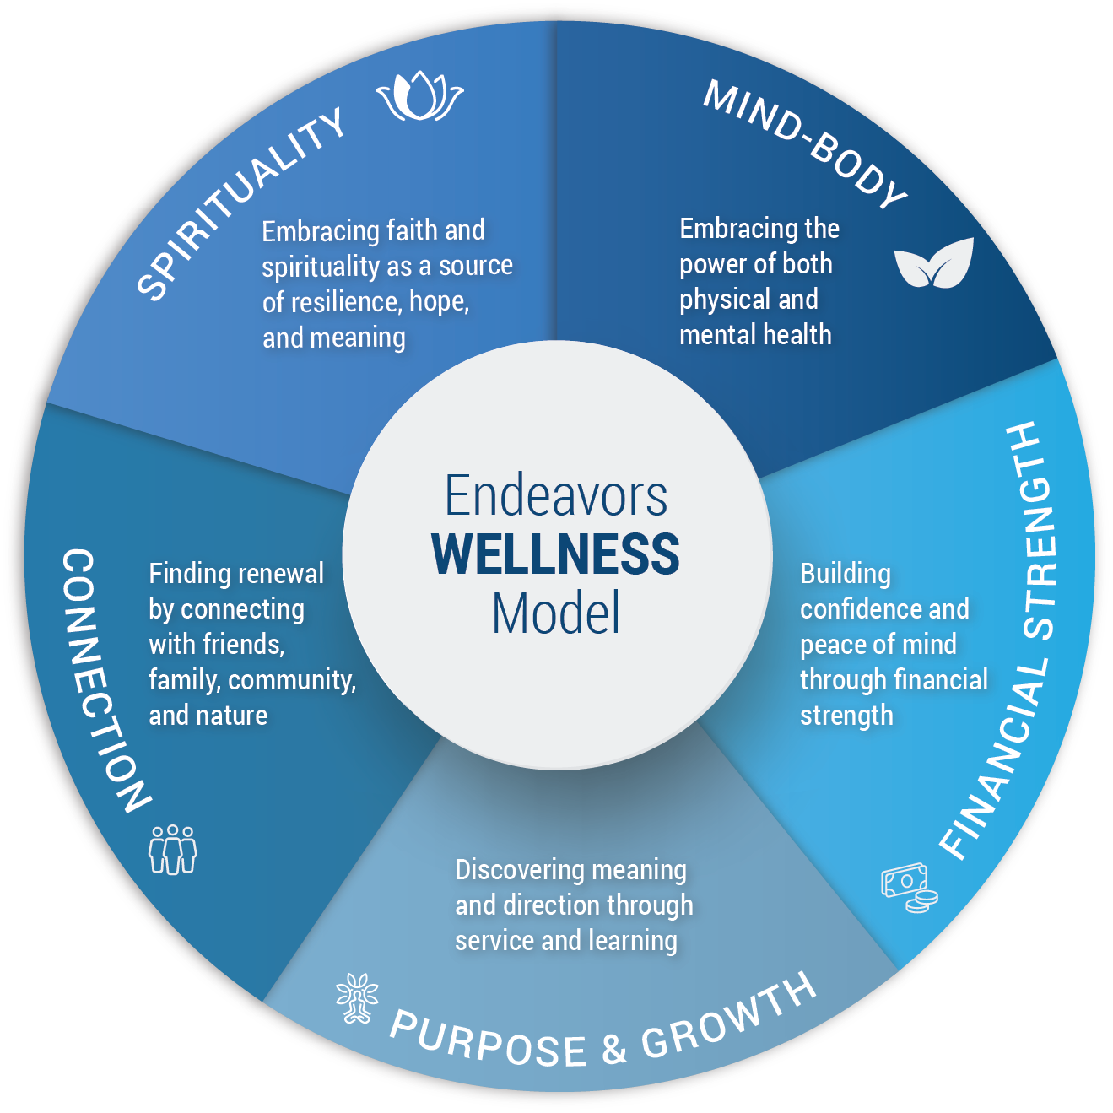
Notes:
The Endeavors Wellness Model presents a holistic approach to well-being, emphasizing that overall wellness is achieved by balancing multiple interconnected areas of life. The model is depicted as a circle divided into five key dimensions: Spirituality, Mind-Body, Financial Strength, Purpose & Growth, and Connection. Each dimension contributes uniquely to a person’s resilience, stability, and sense of fulfillment.
At its core, the model highlights that wellness is not just physical health but a combination of emotional, social, financial, and spiritual factors. The Mind-Body component focuses on maintaining both physical and mental health, recognizing the strong link between how the body feels and how the mind functions. Spirituality emphasizes finding meaning, hope, and resilience through faith or personal beliefs.
The Connection dimension underscores the importance of relationships and community, encouraging individuals to build supportive networks with friends, family, and nature to foster renewal and belonging. Purpose & Growth centers on personal development, learning, and service, helping individuals discover direction and meaning in their lives. Meanwhile, Financial Strength highlights the role of financial stability in building confidence and peace of mind.
Overall, the model illustrates that wellness is an ongoing, dynamic process. Strength in one area can support growth in others, and achieving balance across all five dimensions leads to a more resilient, healthy, and fulfilling life.

Slide 4

Endeavors has supported individuals and families in crisis since 1969 and has served the Uvalde and surrounding areas for more than 10 years. Located at our new location, 1901 Garner Field Rd. Suite 150, in Uvalde, Endeavors provides behavioral health support for community members, first responders, and law enforcement as they begin their journey toward healing.

Slide 5
Communities
We Serve
Uvalde Community Behavioral Health proudly supports rural communities across Southwest Texas, including Uvalde, Bandera, Medina, Real, and Edwards Counties.

Slide 6
Services Offered
Behavioral Health Services for Southwest Texas Communities members can receive FREE:
Behavioral Health Counseling
Medication Management
Case Management
Supportive Housing for Veterans
Relaxation and Wellness Rooms

Slide 7
Behavioral Health Counseling
Confidential, professional support through one-on-one, couples, family, and adolescent counseling (ages 8 and up). Sessions are available in person or virtually with a licensed clinician, providing a safe space to heal, grow, and navigate life.

Slide 8
Medication Management
Expert evaluation and management of psychiatric medications for adolescents (ages 10+) and adults, provided by a board-certified psychiatrist or psychiatric nurse practitioner, provides personalized care to support behavioral health, stability, and overall well-being.

Slide 9
Case Management
Our case managers provide compassionate support designed to help you regain stability, access resources, and move forward with confidence.

Slide 10
Case Management
Emotional & Behavioral Health Support Personalized recovery and support plans
Referrals to behavioral health and trauma-informed care
Crisis stabilization and immediate support
Ongoing check-ins to monitor progress

Slide 11
Case Management
Practical & Financial Assistance: Guidance in accessing financial assistance and relief programs
Connections to housing, healthcare, and family support services
Advocacy with agencies and community partners
Help with completing important forms and applications
Assistance with accessing transportation resources

Slide 12
Case Management
Employment Support: Resume building and cover letter building
Job applications help and local opportunity research
Interview preparation and mock interviews
Career counseling, skills assessment, and goal setting

Slide 13
Supportive Housing for Veterans
Dedicated services for veterans and veteran families experiencing housing instability, including:
VA benefits assistance
Housing resources
Financial and employment support
Workshops to build confidence & resilience

Slide 14
Relaxation & Wellness Rooms
A peaceful, sensory-rich environment designed to help you relax, reset, and reconnect with your well-being.

Slide 15
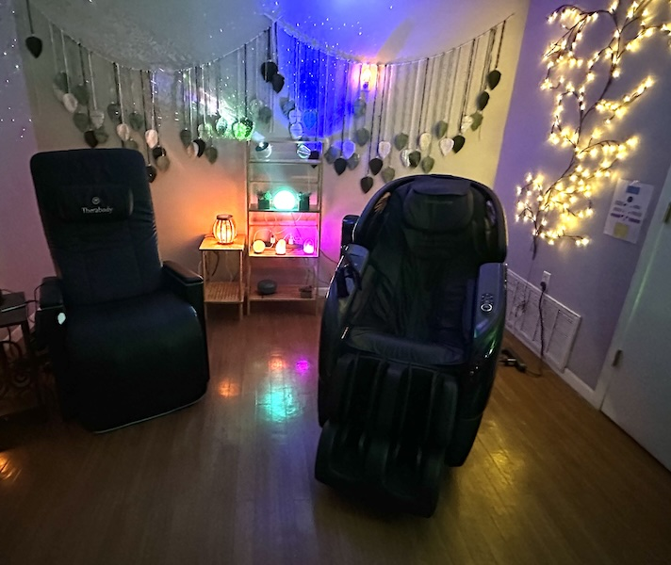
Relaxation & Wellness Rooms

Slide 16
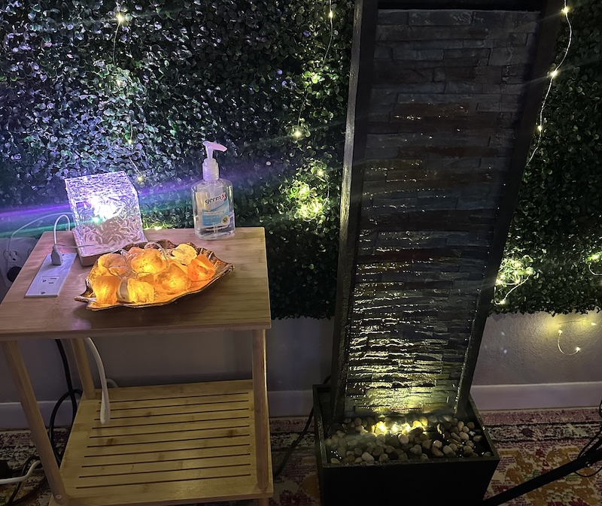
Relaxation & Wellness Rooms

Slide 17
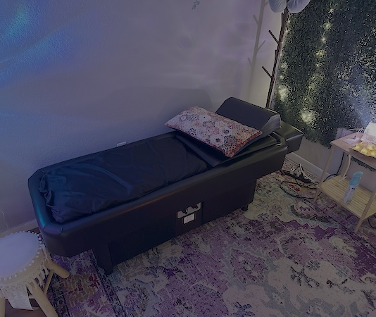
Relaxation & Wellness Rooms

Slide 18
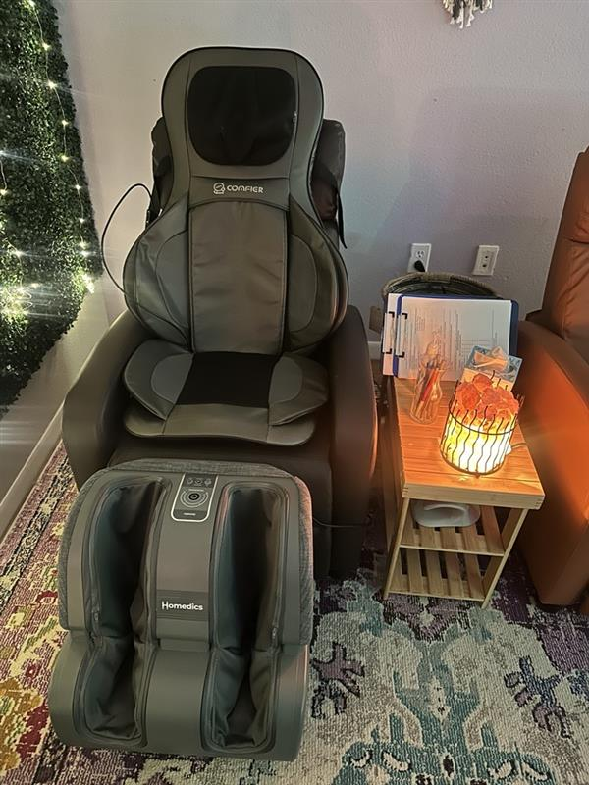
Relaxation & Wellness Rooms

Slide 19
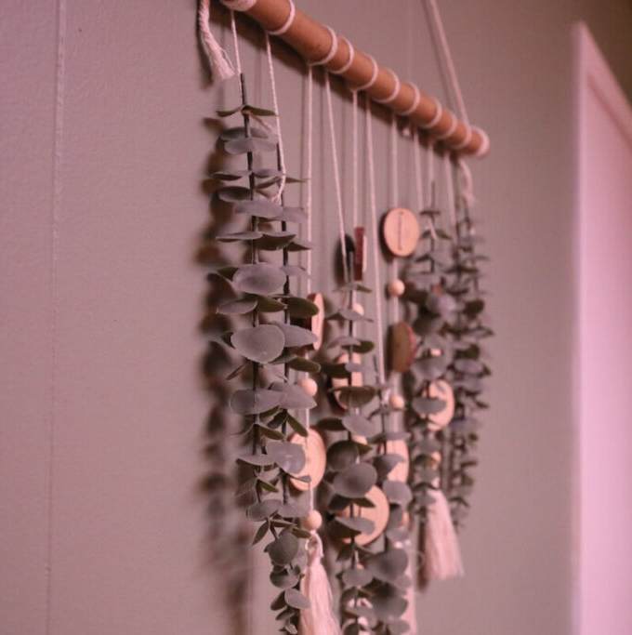
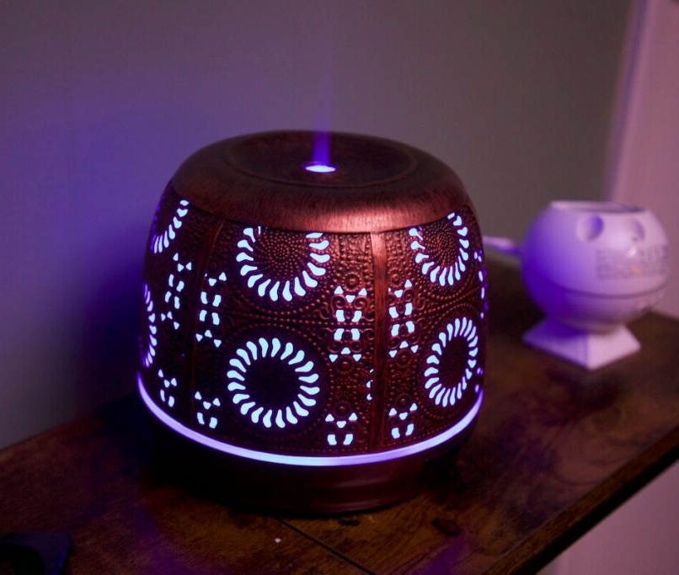
Relaxation & Wellness Rooms
    Relaxation Tools :
Mindful Chair
Hydro Message Table
Compression message Boots
Thera Body Smart Goggles
Full Body Massage Chair
Hypnogogic Light Therapy
Weighted Blankets and More

